Slide 1
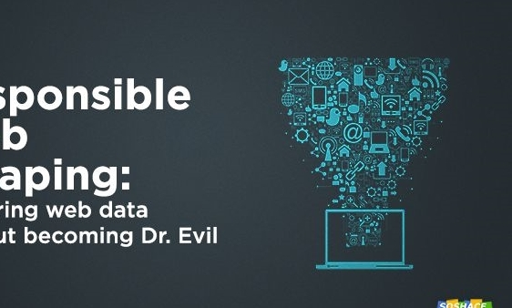

Where is the best place to eat in Austin, Texas
Sunanda Das
fxe000
University of Texas at San Antonio

Slide 2
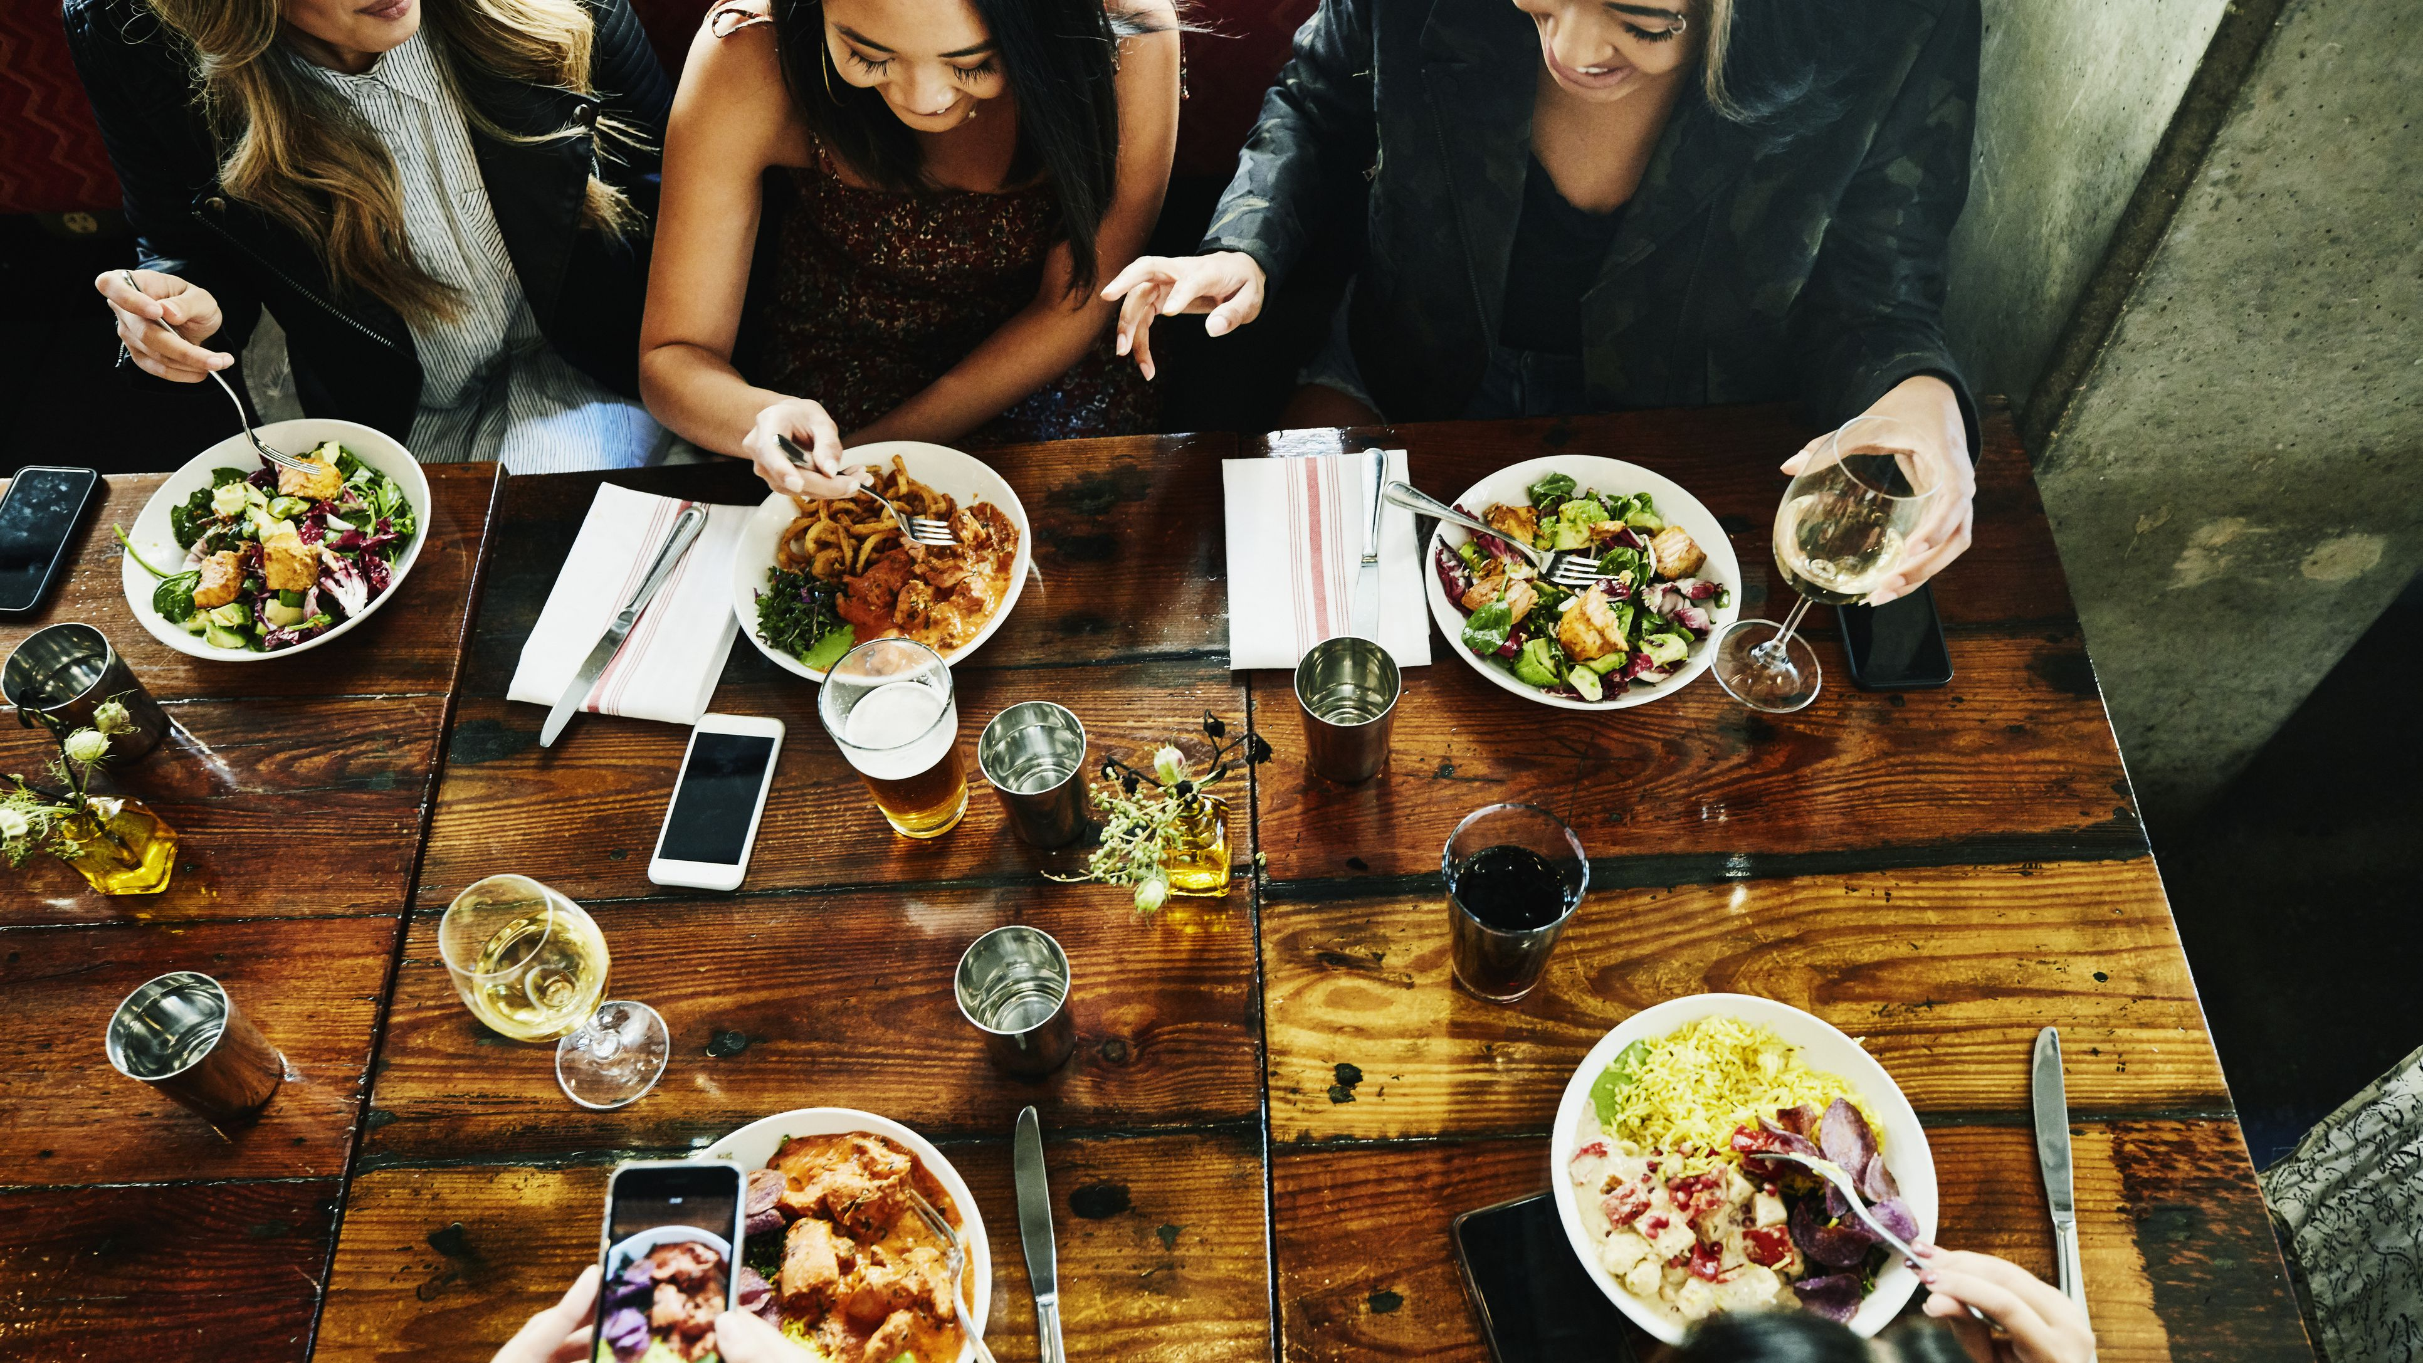
Overview
Motivation
Scraped Data
Analysis
Summary
Difficulties
Future work

Slide 3
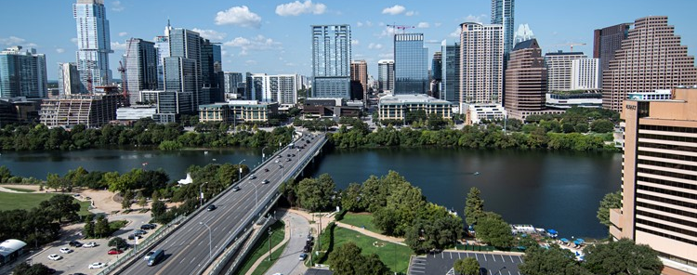
Motivation
Food lover and explore popular food spots near me
Austin has some unique restaurants different from other states and I don’t know how it is.
What’s the most popular cuisines? Which cuisines need more exposure?
Research question:
Where to eat? What type of food? How Expensive?

Slide 4

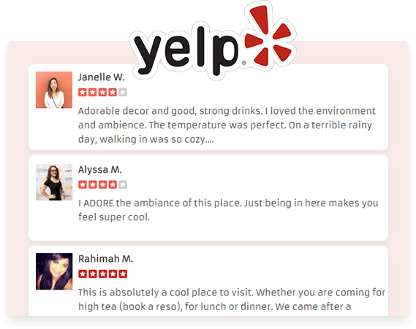
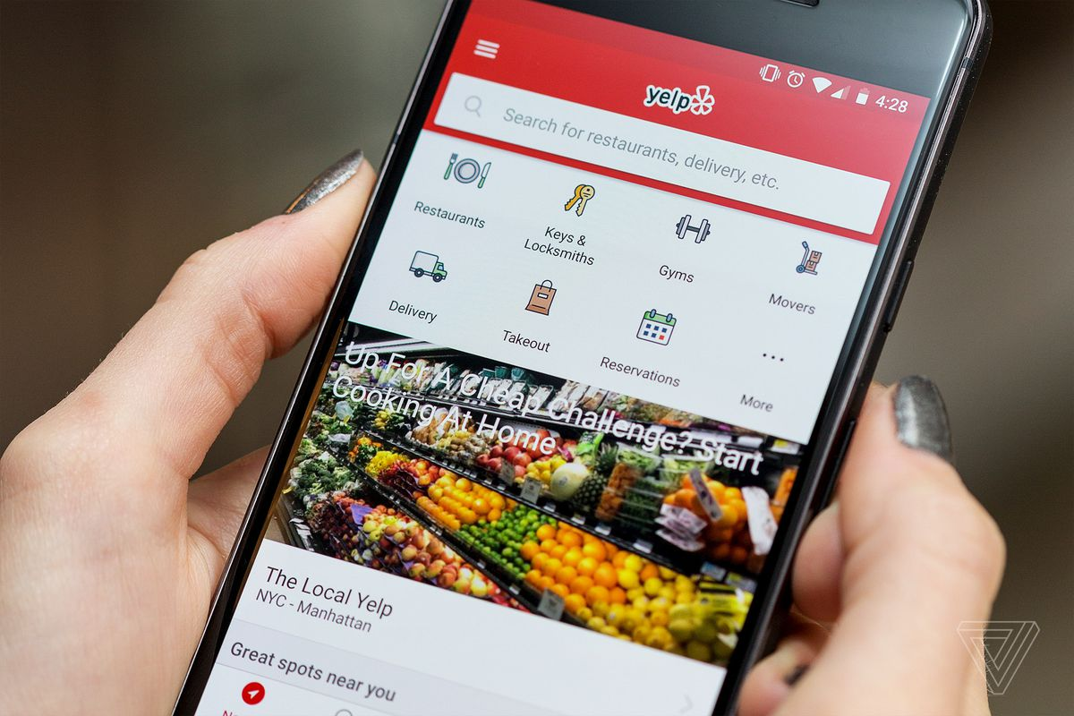
Website
https://www.yelp.com/search?find_desc=Restaurants&find_loc=Austin%2C+TX

Slide 5
The Web Scraping and Cleaning Process
Starting on Yelp main page, I collected all the URL’s of restaurants associated with major 6 cuisines.
The URL's included information about the restaurants. This information was collected from the main page of each cuisine.
Scraped every restaurant for 6 popular cuisines :
American
Asian
Indian
Italian
Mexican
Steakhouse
Collected Data for a total 2203 restaurants

Slide 6
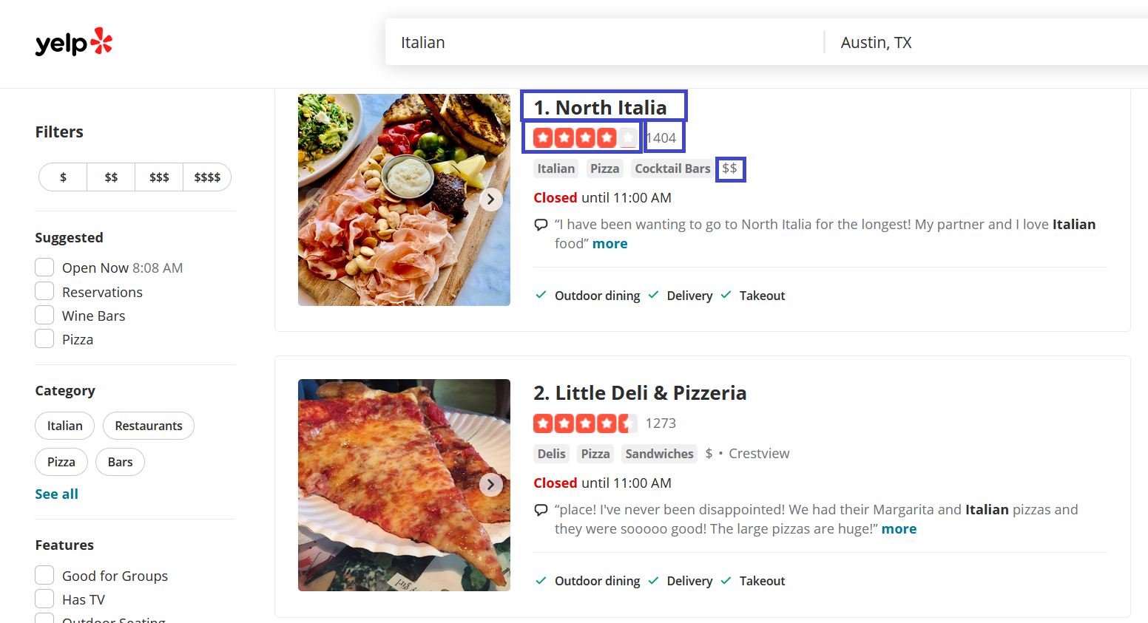
Scraped Data
Price Range
Restaurant Name
Rating
Number of Reviews
$= under $10
$$=$11-$30
$$$=$31-$60
$$$$= over $61

Slide 7
Web Scraping

Slide 8
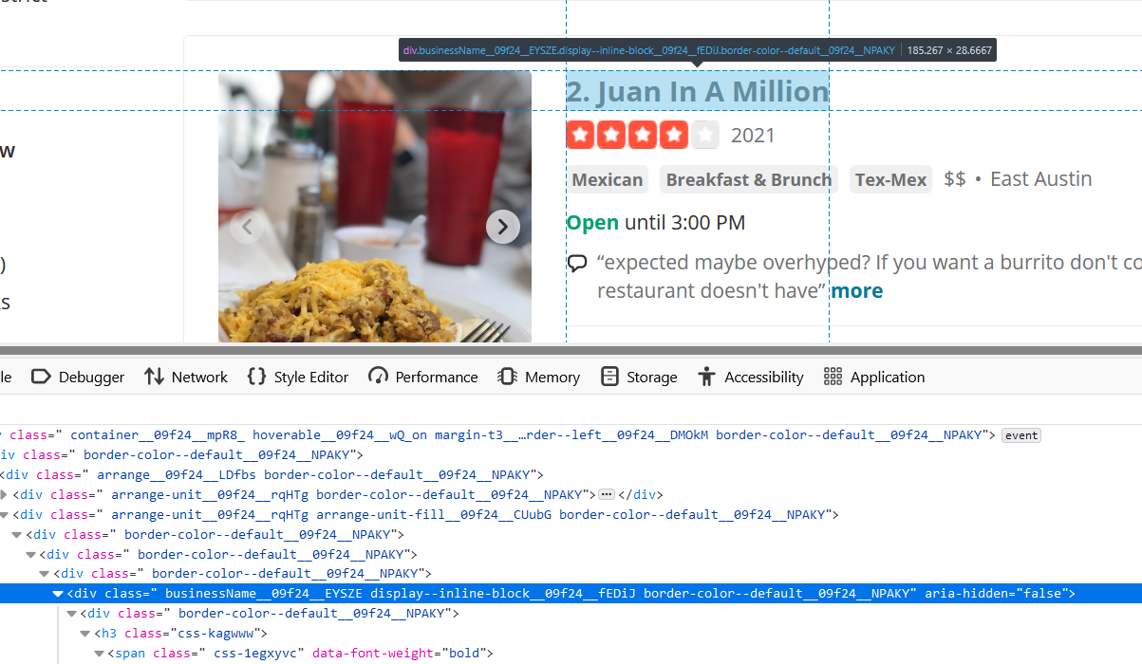

Web Scraping

Slide 9
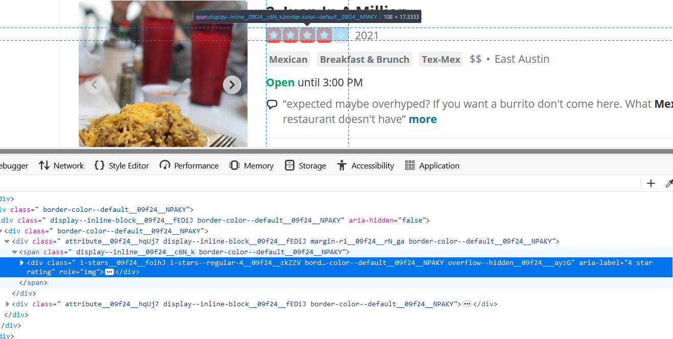
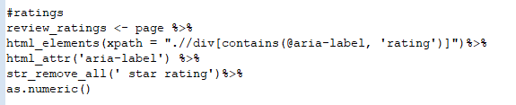
Web Scraping

Slide 10
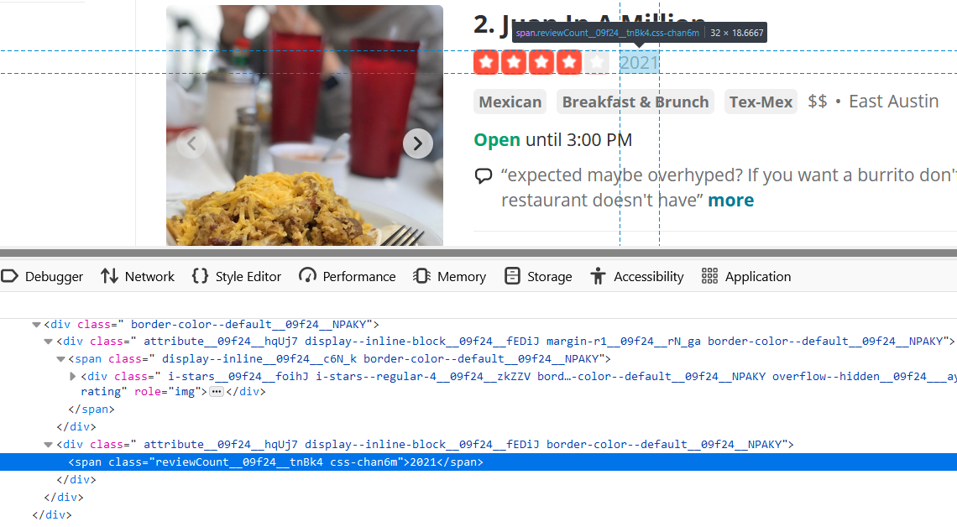
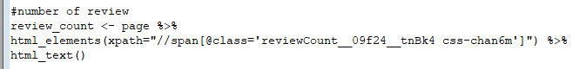
Web Scraping

Slide 11
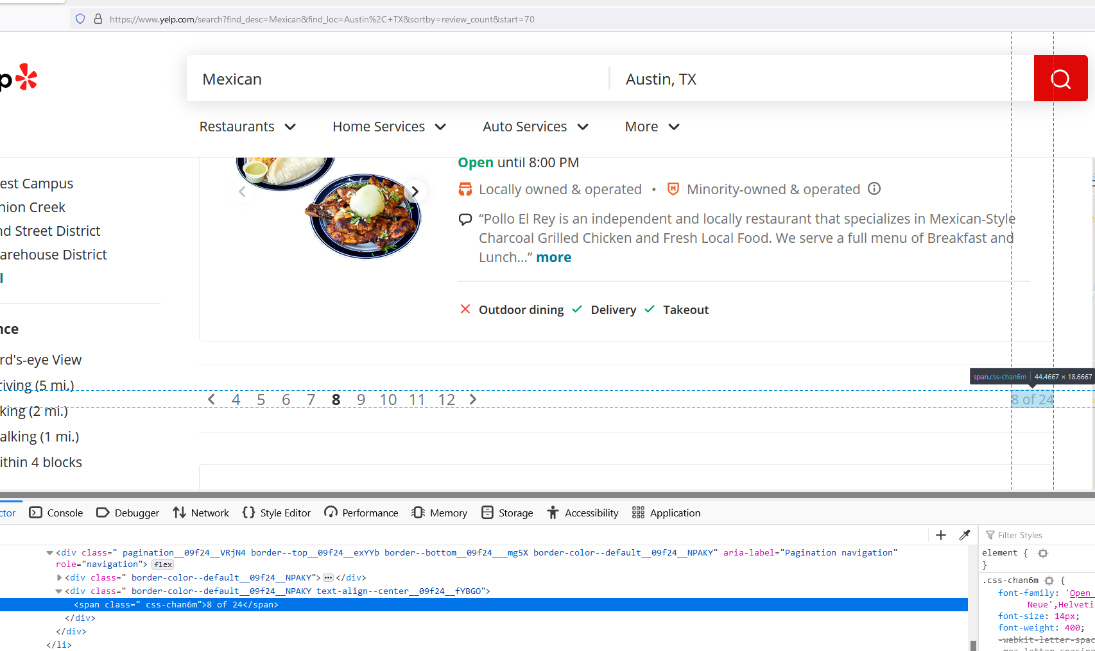
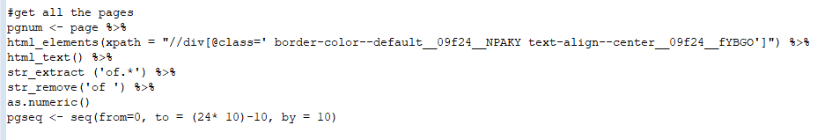
Web Scraping

Slide 12
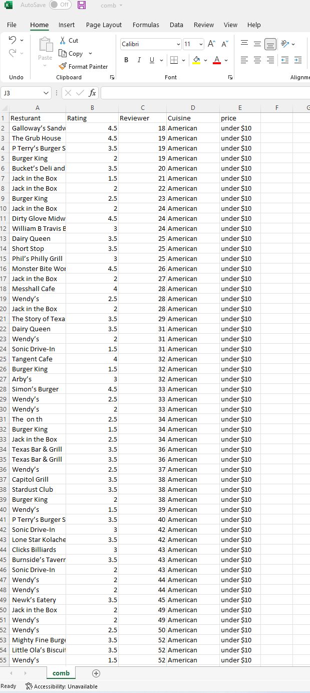
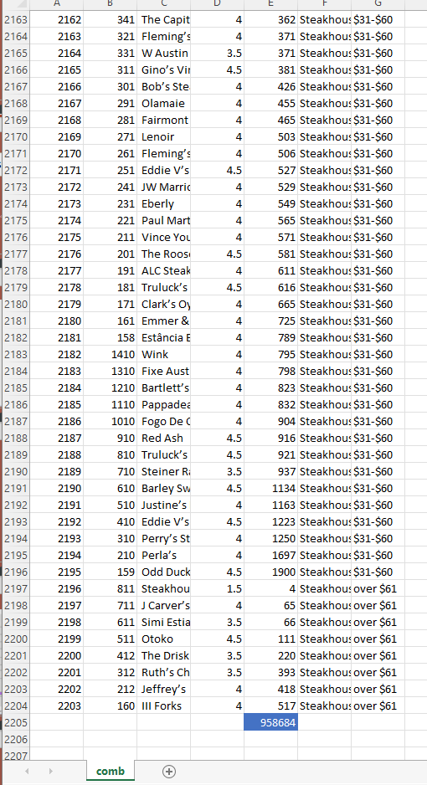
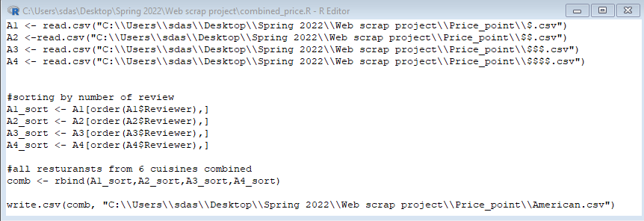

Slide 13
Analysis
Assumptions
Customers has the same likelihood to leave a review independent on whether their experience was
Every review represents a unique customer or group of customers for each restaurant rather than a single customer with multiple reviews for one restaurant
The goal behind my analysis was to determine the optimal cuisine that can be explored in Austin based on the reviews and ratings from Yelp

Slide 14
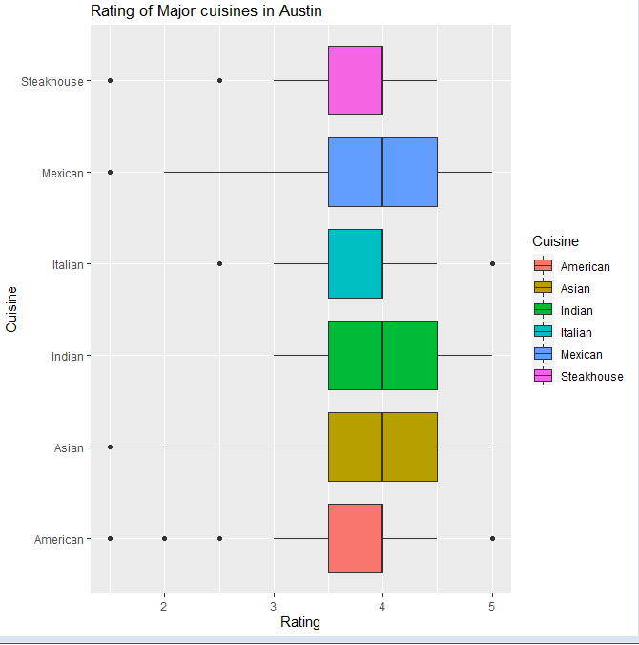
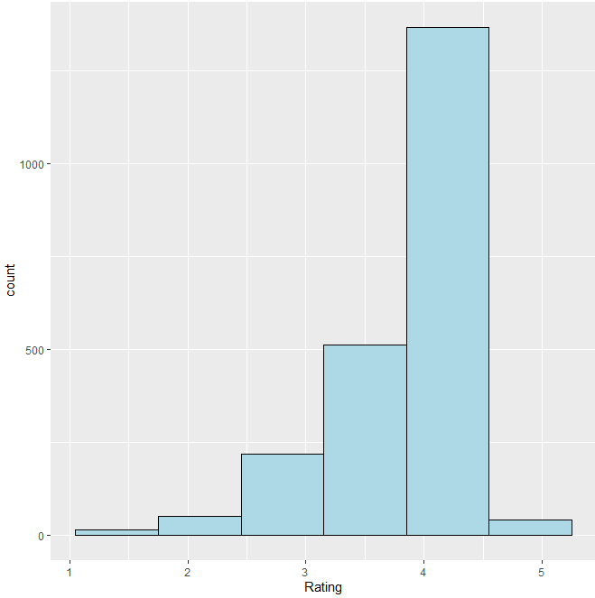
Overall Rating for 2203 restaurants
(irrespective of cuisine types)
Rating of customers on 6 popular cuisines in Austin

Slide 15
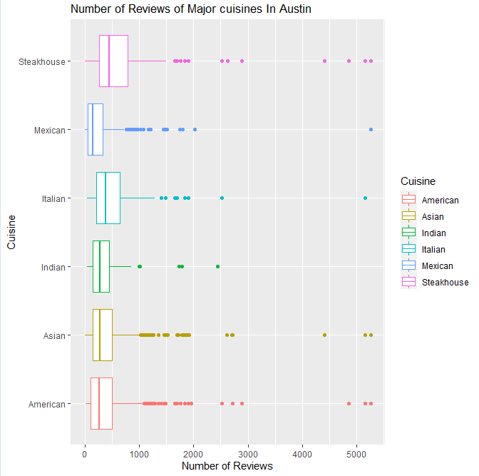

Slide 16
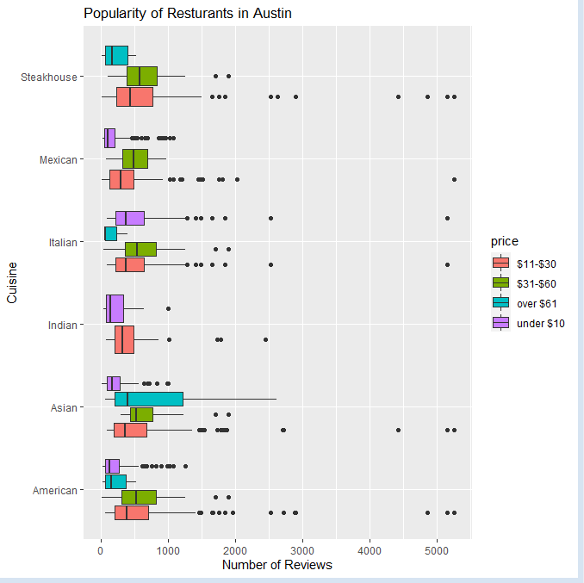
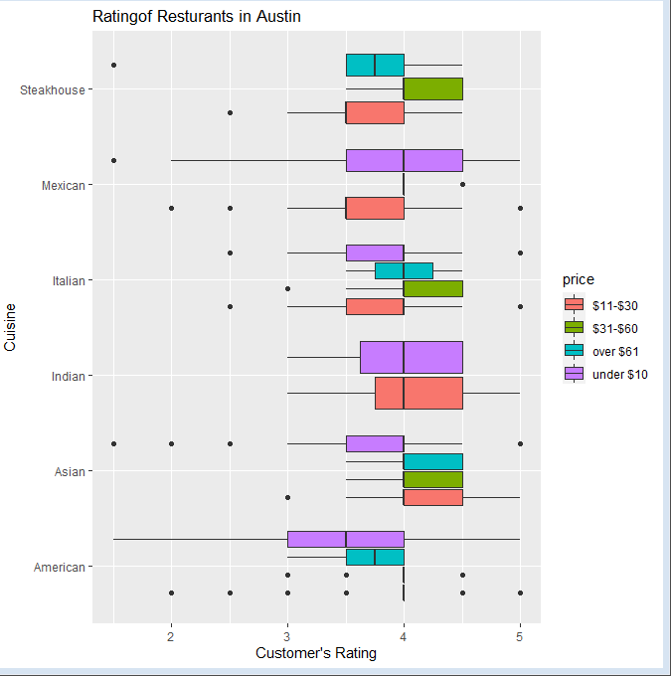

Slide 17

Summary
Budget under $10
Mexican/Italian/Indian restaurants
Budget $31-$60
Steakhouse
Budget $11-$30 or over $60
Asian restaurants

Slide 18
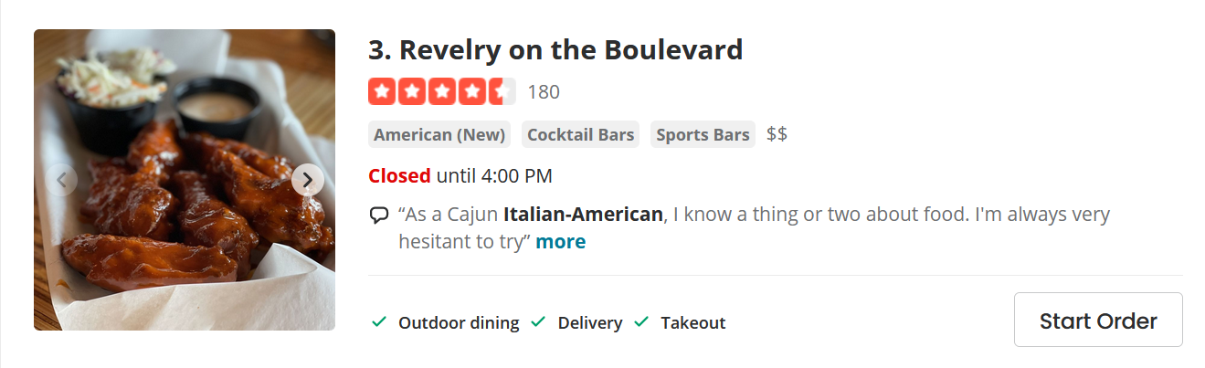
Limitations
Restaurants fall into several industry classifications, based upon menu style
get flagged

Slide 19
Future work
Text analysis
How the reviews have changed over time
Rating analyze
What kind of phrases/words are being used for 5 starts and 1 star
compare restaurant ratings with menu items

Slide 20
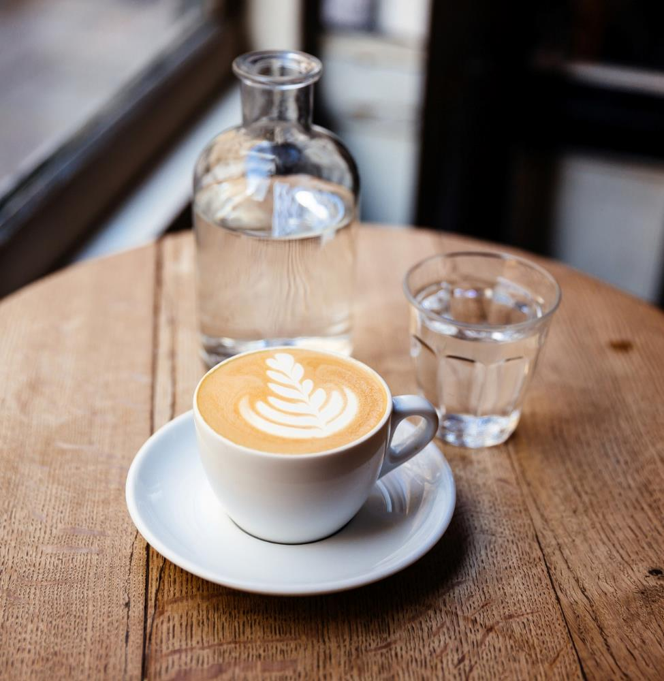
Thank You

